Slide 1
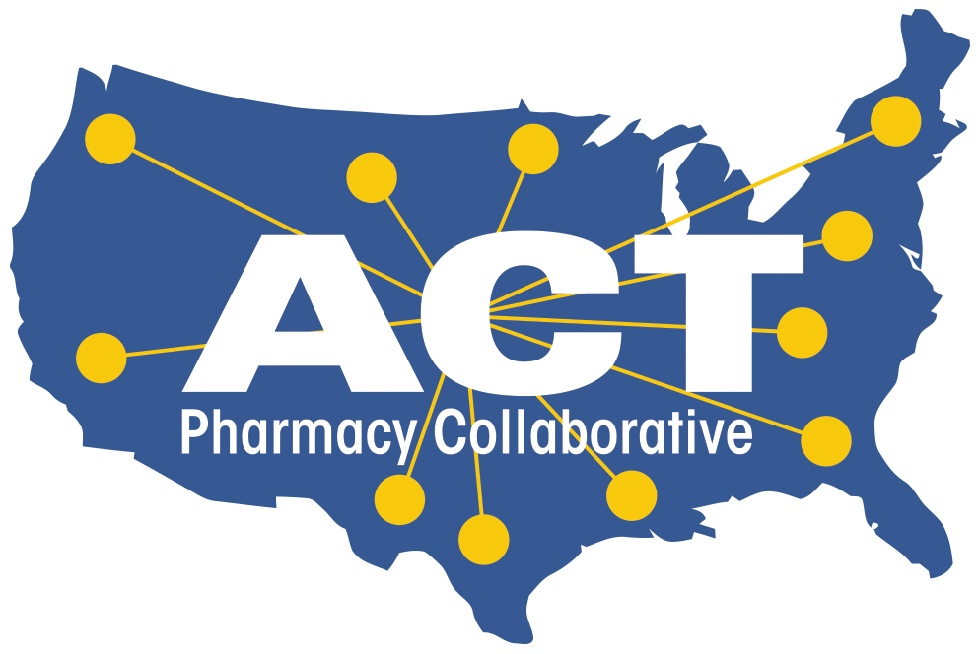
Academia-CPESN Transformation
Pharmacy Collaborative
#ACTforPharmacy | www.actforpharmacy.com | actforpharmacy@pitt.edu

Slide 2
Overview
Formation of ACT Pharmacy Collaborative
Community Pharmacy Practice Transformation Curriculum Framework
Resources available
Next Steps

Slide 3
Notes:
Founding Partners: Community Pharmacy Foundation, University of Pittsburgh, CPESN USA, And American Association of Colleges of Pharmacy
Collaborative partners: National Community Pharmacists Association, American College of Clinical Pharmacy, and American Pharmacists Association

Slide 4
ACT Pharmacy Collaborative
Designed as a direct result of the input and interest expressed by CPESN community pharmacists/owners and faculty at colleges/schools of pharmacy
Collected interest and feedback on shared needs and goals
CPESN Annual Meeting 2019
NCPA Annual Meeting 2019, 2020
AACP Annual Meeting 2019, 2020
APhA Annual Meeting 2020
Founding partners: Community Pharmacy Foundation, University of Pittsburgh, CPESN USA, And American Association of Colleges of Pharmacy
Collaborative partners: National Community Pharmacists Association, American College of Clinical Pharmacy, and American Pharmacists Association
Notes:
CPESN Annual Meeting is the national meeting of community pharmacy owners and local network leadership

Slide 5
97 Schools/Colleges Joined ACT
Committing to
Designate an ACT Champion responsible for facilitating and developing transformative partnerships with CPESN pharmacies
Support initiatives
Yearly reports, student engagement in community pharmacy transformation, webinar participation, engagement with CPESN pharmacies
Ensure school/college faculty are teaching the pharmacist patient care process as it applies to community pharmacy practice
Contribute talent and resources from the institution to advance transformation of community pharmacy practice

Slide 6
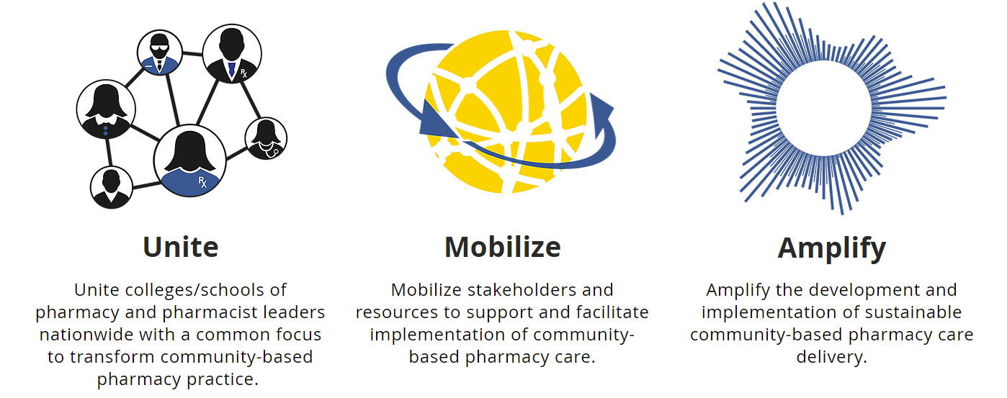
ACT Pharmacy Collaborative
Notes:
The three goals of launching the ACT Collaborative are to unite, mobilize and amplify.

Slide 7
Community Pharmacy Practice Transformation: Why NOW?
Pharmacy student applications continue to decline
COVID-19 made community pharmacy essential
25 states recognize pharmacists as “other health practitioners”
Community pharmacy is the next “ambulatory care” frontier
Community pharmacy data – untapped resource for research
Patients need us
Notes:
The COVID-19 pandemic shone bright light on community pharmacies nationwide. Pharmacies kept their doors open to the public while other health facilities limited patient volume and often turned to telehealth options making it more difficult for patients with limited technology access and health literacy. Pharmacies served as an instant pipeline for the delivery of COVID-19 vaccinations for all age groups delivering over 248.8 million COVID-19 vaccine doses from over 41,000 pharmacies nationwide [CDC https://www.cdc.gov/vaccines/covid-19/retail-pharmacy-program/index.html]. Community pharmacies proved in real time that they are the “front door” to health care and in turn, are the “front door” to the profession of pharmacy. The increase in visibility of pharmacists and their teams as patient care providers has increased opportunities for patient care service contracts, often utilizing medical billing, and at the same time, has created strain on the pharmacy workforce with rapidly changing expectations and delivery of care while the systems and workflow lag.

Slide 8
Developing a Curricular Framework
The ACT Pharmacy Collaborative led the development of a curricular framework sought feedback from faculty and other stakeholders through the Workgroups, the Framework Committee, and sessions held at national association meetings.
Date Range | Activity
April 2021 | ACT Experiential and Curricular Workgroups formed
May 2021 – August 2021 | Workgroup meetings
July 2021 | AACP Annual Meeting (virtual) – over 40 participating faculty
October 2021 | ACCP Annual Meeting – Community Pharmacy Practice Research Network – over 30 participants
January 2022 | Framework review process starts with ACT Framework Committee
March 2022 | CPESN Leadership review
March 2022 | Task Force leaders meet at APhA Annual Meeting to finalize format and begin final writing
June 2022 | Final framework draft sent to Workgroup members for review
Notes:
Together with CPESN pharmacist leaders, faculty leaders, and professional pharmacy associations (AACP, NCPA, ACCP and APhA), we have developed a consensus Community Pharmacy Practice Transformation Curricular Framework for colleges/schools of pharmacy to consider as they revise courses and curricula to meet the changing expectations for delivery of patient care services in community pharmacies nationwide. This document presents a curricular framework (referred to as the Framework) for community pharmacy practice transformation as a recommendation to all schools and colleges of pharmacy. The domains and objectives listed herein are applicable to both didactic and experiential education. We invite you to use this Framework to engage faculty and administrators on curricular design and outcomes to help drive practice transformation.

Slide 9
Recognition of Workgroup Members
Didactic Workgroup
Nick Leon (co-chair) | Jefferson University
Megan Smith (co-chair) | University of Arkansas of Medical Sciences
Michael Andreski | Drake University
Tosin David | University of Maryland Eastern Shore
Kendall Guthrie | University of Missouri-Kansas City
Karl Hess | Chapman University
Brooke Hudspeth | University of Kentucky
Justin Kirby | Lipscomb University
Sarah Lynch | Binghamton University
Traci Poole | Belmont University
Brittany Riley | Marshall University
Michelle Sahr | Ferris State University
Experiential Workgroup
Chris Daly (co-chair) | University of Buffalo
Shelby Bennett (co-chair) | University of Nebraska
Rachel Allen | University of Washington
Jordan Ballou | University of Mississippi
Angela Clauson | Belmont University
Jen Danielson | University of Washington
Ashley Hannings | University of Georgia
Marlowe Djuric Kachlic | UIC
Tera McIntosh | University of Kentucky
Wes Nuffer | University of Colorado
Nicole Pezzino | Wilkes University
Nathan Pope | University of Texas at Austin
Leanne Showman | SWOSU
Kimberly Stultz | University of Florida

Slide 10
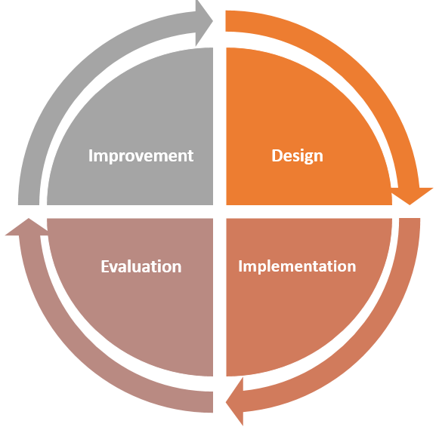
Community Pharmacy Practice Transformation: Vision
Pharmacist graduates of all colleges/schools of pharmacy will be able to:
… of sustainable patient care services alongside the provision of dispensing services.
Notes:
Pharmacist graduates of all colleges/schools of pharmacy will be able to drive practice transformation, equipped with the knowledge and skills to immediately contribute to the design, implementation/delivery, evaluation, and improvement of sustainable patient care services alongside the provision of dispensing services.

Slide 11
Community Pharmacy Practice Transformation Framework: Utility
Advocacy
Provides evidence to help faculty and administration buy-in to the importance
Evaluation
Tools provided to help evaluate each domain
Experiential education
Curricular Revision
Can be used by standing or ad hoc committees to benchmark current curriculum
Co-curriculum
Course level
Support curricular revision efforts
1. The Community Pharmacist Practitioner
2. Evidence-based Community Pharmacy Services
3. Extended Care Team, Community Partners & Payors
4. Caring for Populations & Communities
5. Pharmacy Workflow & Technology
6. Vision Sustainability & Scalability
Notes:
The Framework can be used in several ways through different lenses. Today, I’d like to focus on _____.
Advocacy
Community pharmacy faculty and ACT Champions can use this Framework as supporting evidence to underscore the importance and immediacy of preparing graduates to engage in community pharmacy practice transformation. This document can be utilized as a position paper or a call to action supporting the notion that all schools and colleges of pharmacy should work towards achieving the Framework’s vision.
Course Design
Schools and colleges of pharmacy who wish to increase their program’s efforts to prepare graduates to participate and drive community pharmacy practice transformation can use this document as direction and inspiration as they engage in curricular and co-curricular design at the course and activity level.
Evaluation
Schools and colleges of pharmacy already have community pharmacy practice transformation education within their curriculum. This document can be helpful to inventory, evaluate and identify areas of opportunity to enhance their efforts in this area.
Quality Assurance &Improvement in Experiential Education
Experiential education administrators can find the Framework helpful as they work to identify and collaborate with community pharmacies who are actively engaging or who are interested in engaging in practice transformation. Experiential rotations in community pharmacy settings, at any level, can be designed to include tasks and assignments that map to the domains found in this document to help spark new, or amplify existing transformation efforts.
Curricular Revision
Doctor of Pharmacy programs who are undertaking curricular revision can use this document to create and justify community pharmacy practice transformation related program goals, learning outcomes, and curricular threads that cut across the program and are interwoven with the delivery of other content.

Slide 12
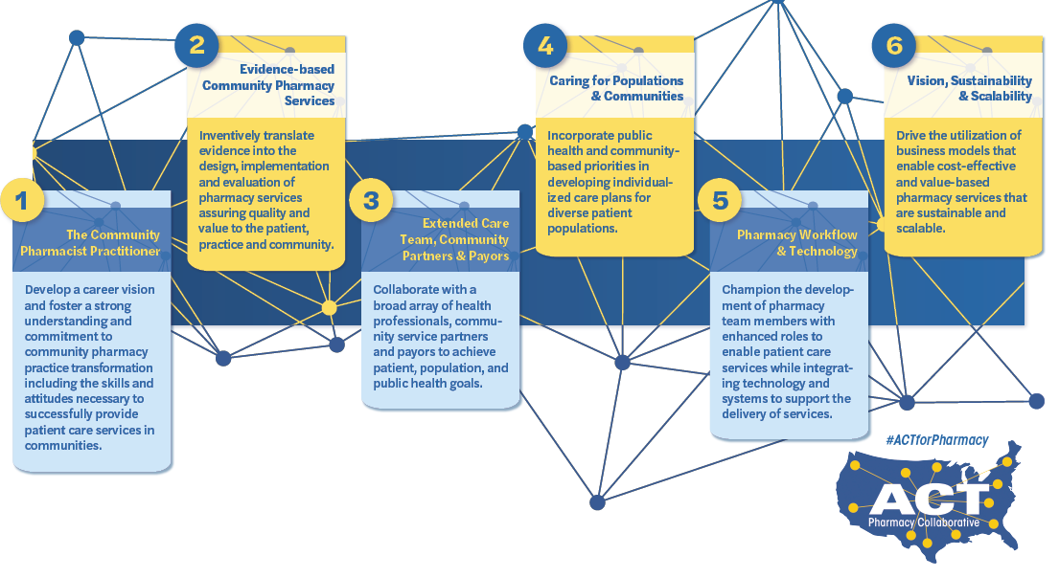
Community Pharmacy Practice Transformation Framework: Domains

Slide 13
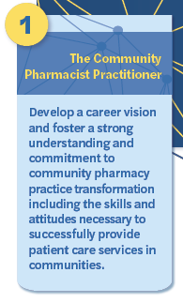
Develop a personalized philosophy of care
Incorporate the principles of clinical pharmacy: “optimize medication therapy and promote health, wellness, and disease prevention”
Develop strong ties to the profession of pharmacy and communities served through:
Professional organization involvement
Profession advocacy (state and national level)
Community engagement and advocacy
Knowledge:
Recognize scope of practice opportunities within state/community
Identify advanced patient care services in communities throughout the nation
Design a routine way to stay up-to-date with new and emerging trends in community practice services and operations, drug therapy and disease specific care
Attitudes:
Act as an empowered professional
Reflect honestly and critically on decisions, actions and performance
Awareness of strengths, liabilities and professional bias
Seek meaningful professional experiences
Practice routine self-care
Notes:
In this era of evolving pharmacy practice, a strong professional identity is needed to cope with uncertainty, drive change and transform practice.^{1,2} Professional identity influences how we perceive, present and conduct ourselves and how we practice. ^{1,3} Professional identity is integral to how students prioritize their roles and responsibilities and allows them to develop a set of standards or internal compass that regulates their professional work. ³ Recent national survey data suggests work attitudes and satisfaction are declining and lowest in community settings.⁴ Colleges and schools of pharmacy play a vital role in professional identity formation (PIF) via the design of the curriculum, experiential education, and co-curriculum.¹ Faculty and preceptors have the opportunity to engage students in PIF through role modelling, mentoring, ongoing self-reflection, exploration of professional values and values conflicts, experiential learning in an authentic practice environment, and creating a welcoming community of practice. ^{3,5,6} Reflection, relationships, and resiliency act in an interconnected and reciprocal way to support professional identity formation and assist students to make meaning within learning. ³ Burnout can impede development of a well-integrated professional identity, while healthy personal and professional identity may attenuate burnout, emphasizing the importance of including well-being in PIF. ³
1. Janke KK, Bloom TJ, Boyce EG, Johnson JL, Kopacek K, O'Sullivan TA, Petrelli HMW, Steeb DR, Ross LJ. A Pathway to Professional Identity Formation: Report of the 2020-2021 AACP Student Affairs Standing Committee. Am J Pharm Educ. 2021;22:8714.
2. Noble C, Coombes I, Shaw PN, Nissen LM, Clavarino A. Becoming a pharmacist: the role of curriculum in professional identity formation. Pharmacy Practice 2014;12(1):380.
3. Wald, Hedy S. PhD Professional Identity (Trans)Formation in Medical Education. Academic Medicine. 2015;90:701-706.
4. Doucette W, Mott D, Kreling D, et. al. National Pharmacist Workforce Study 2019. Accessed July 14, 2022. https://www.aacp.org/sites/default/files/2020-03/2019_NPWS_Final_Report.pdf.
5. Johnson JL, Arif S, Bloom TJ, Isaacs AN, Moseley LE, Janke KK. Preparing Pharmacy Educators as Expedition Guides to Support Professional Identity Formation in Pharmacy Education. Am J Pharm Educ. 2022;4:8944.
6. Noble C, McKauge L, Clavarino A. Pharmacy student professional identity formation: a scoping review. Integr Pharm Res Pract. 2019;8:15-34.

Slide 14
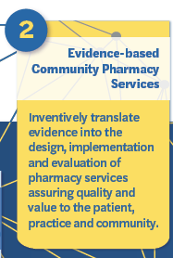
Utilizing pharmacy and community data, identify gaps in patient care services
Apply evidence from the literature to support the development and
evaluation of pharmacy services
Identify specific, evidence-based examples of enhanced pharmacy services:
Appointment-based model with medication synchronization
Vaccination services
Point of care testing and wellness screenings
Comprehensive Medication Management/Medication Therapy Management
Disease-focused medication management (i.e., hypertension, asthma/COPD, diabetes)
Participate in the provision of patient care services including:
Incorporation of the pharmacist patient care process with each patient encounter
Application of therapeutic knowledge of drug and disease states directly to patients
Review and apply policies and procedures for community pharmacy services understanding relevant guidelines, standards of practice, and regulatory expectations
Engage in continuous quality improvement, while including the patient voice, when implementing and evaluating the service
Notes:
Contemporary community pharmacy practice is evolving to focus on a variety of pharmacy services in addition to prescription dispensing. In order to meet the healthcare needs of the patients in their communities, community-based pharmacist practitioners innovate to design and implement services which may take place within the pharmacy walls or meet patients where they are.¹ Just as pharmacists are trained to evaluate medication therapy according to the most up-to-date evidence and literature, pharmacy services must be continuously monitored, assessed, and modified to ensure quality.² Pharmacists who are implementing new services may look to published literature on existing pharmacy services to translate what has worked in the past to provide value and serve a new patient need. ³⁻⁷ As the community pharmacy landscape continues to undergo transformation, creative solutions – in part, inspired by the existing evidence – will be needed to meet the health care challenges of the day and beyond.
Resources and References
1. Goode JV, Owen J, Page A, Gatewood S. Community-Based Pharmacy Practice Innovation and the Role of the Community-Based Pharmacist Practitioner in the United States. Pharmacy. 2019. 4;7(3):106.
2. Al-Quteimat OM, Amer AM. Evidence-based pharmaceutical care: The next chapter in pharmacy practice. Saudi Pharm J. 2016;24(4):447-51.
3. Home. Pharmacist eCarePlan Initiative. https://www.ecareplaninitiative.com/. Accessed June 1, 2022.
4. Point of care testing certificate. https://nacds.learnercommunity.com/Point-of-Care-Testing-Certificate. Accessed June 1, 2022.
5. Immunization schedules. Centers for Disease Control and Prevention. https://www.cdc.gov/vaccines/schedules/index.html. Published February 17, 2022. Accessed June 1, 2022.
6. Pharmacy's appointment based model (ABM). APhA Foundation. https://www.aphafoundation.org/appointment-based-model. Published February 8, 2016. Accessed June 1, 2022.
7. Services available from CPESN Network Pharmacies: CPESN USA. Services available from CPESN Network Pharmacies | CPESN USA. https://www.cpesn.com/payors/services-available-from-cpesn-network-pharmacies/. Accessed June 1, 2022.

Slide 15
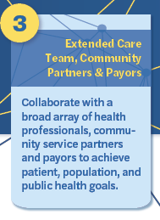
Recognize how the pharmacy is/can be an access point to health services
Support local community events and groups through partnerships, provision of care services at events (i.e., vaccinations or wellness screenings), and/or sponsorship/marketing of events
Establish patient-centered relationships with patients, families, and caregivers as a part of the extended care team
Support the development of relationships with local prescribers and their practice teams
Initiate and support referrals of care to resources in the community
Identify and engage with stakeholders:
Community organizations
Government agency officials
Health plans
Health-systems and/or prescriber practices
Local businesses (i.e., local gym, library, community center, etc)
Notes:
Team-based care is widely accepted as a critical component of healthcare delivery. The ACPE Standards 2016 place an emphasis on schools and colleges of pharmacy providing interprofessional education (IPE) with prescribers and other healthcare professionals, specifically focusing on elements related to team dynamics, education, and practice.¹ The emphasis on IPE is unlikely to change; however, there are signals that healthcare is expanding its definition of team-based care.
In 2019 the Agency for Healthcare Research and Quality (AHRQ) published Care Management – An Implementation Guide for Primary Care Practices where they describe numerous definitions of care management and care managers.² In this document, the authors lean into the broad and diverse definitions and role descriptions of care management and care managers. While care managers are usually healthcare professionals, depending upon the needs of the patients and practice setting, one could easily extrapolate the individual(s) and the role(s) to those who are not stereotypically considered healthcare professionals.² For instance, the CMS Innovation Center, Transforming Clinical Practice Initiative (TCPi) published a document titled Next Steps in Team Based Care which defines health as a community issue and provides reasons that non-clinical neighbors (ex., community centers, employers, public health agencies, etc.) must communicate and work with clinical partners, such as pharmacists, in order to enhance health.³
The shift for a more broad and inclusive view of team-based care is familiar to pharmacists who themselves have been advocating for inclusion across healthcare for decades. As these efforts continue to be successful, new challenges in executing team base care arise that necessitate pharmacists to work with an expanded array of partners and stakeholders. For example, community pharmacies who focus on providing and documenting billable services have had to work with health information technology (HIT) professionals to establish pathways for documenting clinical interventions in a standardized manner, in a language that is compatible with traditional electronic health records. Additionally, successful payment of billable services requires interfacing with billing professionals, which may be located within the pharmacy as well as within managed care organizations. In order to meet the needs of different stakeholders, some community pharmacies have begun broadening how they view personnel and roles within the walls of the pharmacy (ex., employing community health workers) so that they may better achieve patient, payer, population, and public health goals.⁴
Resources and References
1. American Council for Pharmacy Education. Accreditation standards and key elements for the professional program in pharmacy leading to the doctor of pharmacy degree. 2015. https://www.acpe-accredit.org/pdf/Standards2016. Accessed June 8, 2022
2. Care Management – An Implementation Guide for Primary Care Practices. Content last reviewed November 2019. Agency for Healthcare Research and Quality, Rockville, MD. https://www.ahrq.gov/evidencenow/tools/care-management.html. Accessed June 8, 2022
3. Transforming Clinical Practice Initiative (TCPi). Next Steps in Team Based Care. Centers for Medicare and Medicaid Services (CMS), Baltimore, MD. https://innovation.cms.gov/files/x/tcpi-changepkgmod-nextsteps.pdf. Accessed June 8, 2022
4. Community Health Workers in Community-based Pharmacy Care Delivery – Introduction. https://ncpa.org/community-health-workers-intro-video. Accessed June 8, 2022.

Slide 16
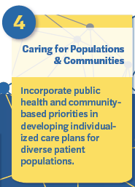
Address social determinants of health within the provision of pharmacy services
Partner with public health organizations (i.e., local and regional departments of health) in connecting patients to care resources
Actively utilize local population data to identify community needs
Design and implement pharmacy services that incorporate public health needs
Incorporate precision public health – utilizing pharmacy and community specific data to drive patient care (i.e., infection outbreak, incidence of drug overdoses)
Notes:
The profession of pharmacy has had profound impact on individual and community health. The primary public health role that pharmacists oversee is promoting the safe and effective use of medications through dispensing. Pharmacists evolving roles during the pandemic demonstrated expanding care opportunities improving society’s overall wellbeing^{1,2}.
Pharmacists are leaders in their communities, putting them in an ideal position to advocate for policies aimed to improve health. Pharmacists assure the health of communities through a range of activities including educating other health professionals on medication use to conducting health screening programs³. Integration of public health principles into accreditation and curricular guidelines have been embraced by schools and colleges of pharmacy. Foundational activities to prepare pharmacy students are aimed at providing both patient-specific and population-based care.
An emerging area of importance in public health is adequately addressing social determinants of health (SDOH). SDOH is defined as the conditions in the places where people live, learn, work, and play that affect a wide range of health and quality-of life-risks and outcomes⁴. Community pharmacists, one of the most accessible healthcare providers, have deployed various pharmacist-led interventions that address SDOH to improve patient’s access to healthcare⁵.
The public health approach around improving health literacy impacts patient care involving the community pharmacist. Low health literacy is associated with poorer health outcomes including increased hospitalizations and emergency care and decreased ability to demonstrate how to take medications properly and to comprehend medication labels⁶. Developing the skills necessary to be effective in improving these outcomes were integrated into course curricula and application of these concepts into a university campus health fair led to modest improvement in pharmacy student’s health literacy skills⁷.
Resources and References
Visacri MB, Figueiredo IV, Lima TM. Role of pharmacist during the COVID-19 pandemic: A scoping review. Res Social Adm Pharm. 2021;17(1):1799-1806. Doi:10.1016/j.sapharm.2020.07.003
Bragazzi NL, Mansour M, Bonsignore A, Ciliberti R. The Role of Hospital and Community Pharmacists in the Management of COVID-19: Towards an Expanded Definition of the Roles, Responsibilities, and Duties of the Pharmacist. Pharmacy (Basel). 2020;8(3):140. Published 2020 Aug 7. Doi:10.3390/pharmacy8030140
Hobson EH, Haines SL, Van Amburgh JA. 2010. Meeting the challenge of public health information delivery in the digital age. J Am Pharm Assoc 50:214.
CDC. Social Determinants of Health: Know What Affects Health. https://www.cdc.gov/socialdeterminants/about.html. Accessed 6/8/22.
Elliott JP, Christian SN, Doong K, Hardy HE, Mendez DD, Gary-Webb TL. Pharmacist Involvement in Addressing Public Health Priorities and Community Needs: The Allegheny County Racial and Ethnic Approaches to Community Health (REACH) Project. Prev Chronic Dis. 2021;18:E07. Published 2021 Jan 28. Doi:10.5888/pcd18.200490
Berkman ND, Sheridan SL, Donahue KE, Halpern DJ, Crotty K. Low health literacy and health outcomes: an updated systematic review. Ann Intern Med. 2011;155(2):97-107. doi:10.7326/0003-4819-155-2-201107190-00005
Earl GL, Harris EM, Dave M, Estriplet-Jiang J. Implementing a health literacy module fostering patient-centered written communication in a cardiovascular prevention elective course. Curr Pharm Teach Learn. 2019;11(7):702-709. doi:10.1016/j.cptl.2019.03.008

Slide 17
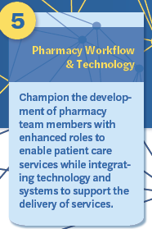
Workflow:
Develop and support new roles for non-pharmacist staff
Gain skills in managing and supporting non-pharmacist staff while ensuring financially viable practice
Utilize the appointment-based model as the foundation of the patient care services workflow
Technology:
Embrace technology and automation solutions for services
Incorporate the use of the eCare Plan standard for documentation of services
Encourage the development of relationships with prescribers to enable the use of electronic health record communication
Seek knowledge of digital health tools and incorporate where appropriate into patient care services
Notes:
Community pharmacy practice is expanding from its traditional dispensing role to offering enhanced clinical services, public health initiatives, and increasing coordination of care within the health team.¹⁻⁴ As these services grow, the ability for pharmacists to document their interventions is necessary to demonstrate their value, participate in health information exchange with providers, and for payment of services.
In response, pharmacy health information technology has expanded substantially to support implementation of clinical documentation within pharmacies.⁵ The IT infrastructure of clinical documentation within community pharmacies is known as the Pharmacists eCare Plan⁶ and has been adopted by 20 pharmacy software vendors. However, incorporating clinical services and documentation requires significant modification of the traditional pharmacy workflow. Incorporation of clinical services into traditional pharmacy workflow has had slow uptake; the most successful practices are those with a separate clinical workflow in which the traditional dispensing workflow can inform the clinical services⁷. Schools and colleges of pharmacy must equip students with the knowledge of these resources and how they are changing to practice in the future.
Resources and References
1. Smith MG, Ferreri SP. A model to inform community pharmacy's collaboration in outpatient care. Res Social Adm Pharm. 2016;12(3):529-534.
2. Smith MG, Ferreri SP, Brown P, Wines K, Shea CM, Pfeiffenberger TM. Implementing an integrated care management program in community pharmacies: A focus on medication management services. J Am Pharm Assoc. 2017;57(2):229-235 e1.
3. Turner K, Weinberger M, Renfro C, Powell BJ, Ferreri S, Trodgon JG, et al. Stages of change: moving community pharmacies from a drug dispensing to population health management model. Med Care Res Rev. 2019.
4. Smith MA, Spiggle S, McConnell B. Strategies for community-based medication management services in value-based health plans. Res Social Adm Pharm. 2017;13(1):48-62.
5. Spiro S. Digital transformation of pharmacists' clinical services. J Am Pharm Assoc. 2019;59(2):S8-S12.
6. Pharmacist eCare Plan Version 1.0 Guidance on the Use of the HL7 CDA Consolidated Templates for Clinical Notes R2.1 Care Plan. National Council for Prescription Drug Programs. 2016. Available from: https://www.ncpdp.org/NCPDP/media/pdf/Pharmacist-eCare-Plan.pdf. Accessed April 22, 2022.
7. Flip the Pharmacy. Content Library. https://www.flipthepharmacy.com/content-library. Accessed May 16, 2022.

Slide 18
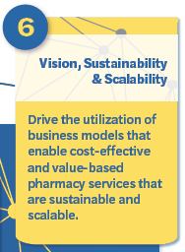
Articulate the value of the pharmacy services to patients, community/health care partners, payors, and the community at-large
Support the development of business plans to support initiating and sustaining patient care services
Navigate the credentialling process of health payors for pharmacist services
Outline the general components of value-based contracting
Identify payment paths for pharmacist services including medical billing and pharmacy-services billing
Explore marketing strategies for patient care services including social media, news outlets, and direct to community
Notes:
Schools and colleges of pharmacy are constantly challenged to produce a product (i.e., new graduates) that is valued in the marketplace.¹ It is estimated that 50 – 60% of pharmacists are employed by community pharmacy^{1,2}, yet there is a well-documented gap between the pharmacist that schools and colleges produce (driven by accreditation standards), and the pharmacist jobs available in community pharmacies (driven by current reimbursement structures).^{1,3}
Adding to this gap, even community pharmacies themselves seem to have different definitions of what they value in a pharmacist. The 2019 AACP workforce survey showed that there is variability in care activities across different community pharmacy settings. For instance, among community pharmacy survey respondents the provision of comprehensive mediation management occurred in 37.5% of large chain pharmacies, 49% of independent pharmacies, and 62.5% of supermarket pharmacies.²
So what is the solution when academia is preparing graduates for a role in community pharmacies that is not universally accepted and when the care activities conducted at community pharmacies is not ubiquitous? The answer, in part, is to lean into what is universal and ubiquitous across different elements of community pharmacy – a focus on their business model.¹
Sorensen and colleagues provide the beginnings of a potential roadmap.⁴ In their 2019 article, they argue that schools and colleges of pharmacy (via their curriculum, faculty and preceptors) should work to establish that pharmacist provided care positively affects quality and cost; that the care provided is unique to pharmacists; and that the care provided by pharmacists (which is determined to be valuable) is delivered consistently.⁴ In 2020, Brown echoed this call when he stated that academia should prioritize “creating and justifying new fiscally sound practice models, and then integrate the training of such entrepreneurial skills into their pharmacy practice experiences.”⁵ Whether it is comprehensive medication management or other patient care services, curricula across schools and colleges of pharmacy should work to enable community pharmacy-related business models (among other settings) to examine, exploit, and scale the value that results from high quality pharmacist provided care.
Resources and References
1. Lebovitz L and Eddington ND. Trends in the Pharmacist Workforce and Pharmacy Education. Am J Pharm Educ. 2019;83(1): 7051.
2. American Association of Colleges of Pharmacy. Resources, pharmacy workforce center, national pharmacist workforce studies, 2019 national pharmacist workforce study.
https://www.aacp.org/article/national-pharmacist-workforce-studies. Accessed June 8, 2022
3. Trygstad T. A Sleeping Giant: Community Pharmacy’s Potential is Unrivaled. J Manag Care Spec Pharm. 2020; 26(6):705-708.
4. Sorensen TD, Hager KD, Schlichte A, Janke K. A Dentist, Pilot, and Pastry Chef Walk into a Bar…Why Teaching PPCP is Not Enough. Am J Pharm Educ. 2020;84 (4): 7704.
5. Brown DL. Years of Rampant Expansion Have Imposed Darwinian Survival-of-the-Fittest Conditions on US Pharmacy Schools. Am J Pharm Educ. 2020; 84 (10): 1277-1281.

Slide 19
Tools/Resources Available
Rubric to evaluate curriculum
Checklists for experiential education
Course-specific materials available online (slides, assessments, etc.)

Slide 20
Next Steps for Us
Add here your call to action
Examples
Department meeting as a community pharmacy update
Curriculum committee to review domains for areas of need
Sub-group to evaluate where synergies occur
Brainstorm session or addition to retreat agenda

Slide 21
Thank you!
#ACTforPharmacy | www.actforpharmacy.com | actforpharmacy@pitt.edu
Twitter/Instagram/Facebook: @actforpharmacy

